Slide 1
Software Defined Concurrency Control for Hadoop Rohan Naik
Project Review
Software Defined Systems EEL 6871 – Fall 17

Slide 2
Problem Statement
Concurrency Control at runtime by dynamic reconfiguration of Hadoop Cluster using Software Definition, to reduce makespan* of MapReduce jobs and optimize performance.
Benefits over other Optimizations:
No training model required
Independent of workload characteristics
No modification in framework (Built on top of existing framework)
makespan*: Overall execution runtime of a MapReduce workload

Slide 3
Background
Resource Manager
Application Manager
Capacity-scheduler
Application Master
YarnChild
(Courtesy: Lecture Slides EEL6871 – Dr. Jose Fortes)

Slide 4
Approach
Defined two tuneable parameters as control inputs for the system
MaxJobs: Total Number of MR jobs taken up by scheduler to run on cluster Changed by yarn APIs
MaxContainers: Number of computing resource units on Slave nodes (Indirectly = AMRP) Changed by yarn APIs

Slide 5
Approach – Resource Utilization Control
Resources include CPU, IO(Disk r/w, Network B/w), Memory
Depending on nature of job, monitoring and controlling one of the above resource can increase efficiency of another or vice versa
This implementation only considers CPU utilization as control metric
By controlling MaxContainers on each slave node we can control the resources occupied by MR job running on that slave node
By controlling MaxJobs on master node we can control the overall resources occupied on the cluster

Slide 6
Components
Local Monitor: A shell script that collects [NodeInfo:, CPU usage, number of context switches, %Memory used, max. device utilization | TaskInfo: CPU usage (%) by MR tasks, memory usage (%) by MR tasks, number of containers used by tasks, number of AMs, number of YarnChild] on each node every 1 second and writes to local logfile
Global Monitor: A shell script that collects data from local monitors and aggregates CPU utilization of entire cluster
Local Controller: Python Script takes data from local logfile and controls MaxContainers based on %CPU utilization threshold defined in program
$yarn rmadmin -updateNodeResource <NodeID> <Memory> <vcores>
WAS USED to update MaxContainers and $yarn node -list to obtain Node IDs

Slide 7
Components
Global Controller: Python script computes aggregate cluster CPU utilization and controls MaxJobs by changing AMRP value in capacity scheduler in runtime.
Used ElementTree API to change the value of AMRP in capacity-scheduler.xml [6].
After every update in xml file, used the command refreshQueues to update the value in Hadoop Daemon[2]

Slide 8
Components
In context of a MAPE Controller design following analogies can be established:
Monitors/ Logfiles: Monitoring
Controllers: Analyze and Plan
Yarn and Etree APIs: Execute

Slide 9
Controller Architecture
Courtesy: Lee, Gil Jae, and José AB Fortes. "Hierarchical Self-Tuning of Concurrency and Resource Units in Data-Analytics Frameworks." Autonomic Computing (ICAC), 2017 IEEE International Conference on. IEEE, 2017.

Slide 10
Control Logic – LOCAL
First Line of Defence for over/ underutilization
(Moving Average Filter n = 10 Used)
→ %CPU < Lower Threshold
Underutilization -Add containers
→ %CPU > Upper Threshold
Max Limit Reached - Reduce Containers
Else: Stable State → Do Nothing
PSEUDO CODE:
If NodeCPU < Lower Threshold:
MaxContainer = MaxContainer + 1
IncrementFlag = True
wait waittime
Else if NodeCPU > Upper Threshold:
MaxContainer = MaxContainer -1
DecrementFlag = True
wait waittime
Else: Steady State Region → Do Nothing

Slide 11
Control Logic - GLOBAL
When aggregate resource utilization remains under or overutilized
i.e. When aggregate resource utilization < global threshold &&
MaxContainers not utilized fully → Increase MaxJobs (AMRP)
When aggregate resource utilization > global threshold &&
MaxContainers not utilized fully Decrease MaxJobs (AMRP)
Both Global and Local controller together aim at keeping CPU utilization near 90% either by increasing Number of Jobs or Resources for a starving job.

Slide 12
Experimental Setup - CLOUDLAB
Property settings and Threshold values:
Slaves: 2
Container Size: 1024
Initialization value of slaves:
→32 GB, 32 Containers Allowed
Initialization value of AMRP: 0.2
Maximum AMRP allowed: 0.7
Local Controller CPU usage:
Average>90, decrease containers
Average<70, increase containers
70<Average<90 do nothing – all is well!
(values require finetuning)
Global Controller aggregate usage:
Total Resource >180, decrease maxjobs
Total Resource < 140, increase maxjobs
70<TR<90 do nothing – all is well!
(values require finetuning)

Slide 13
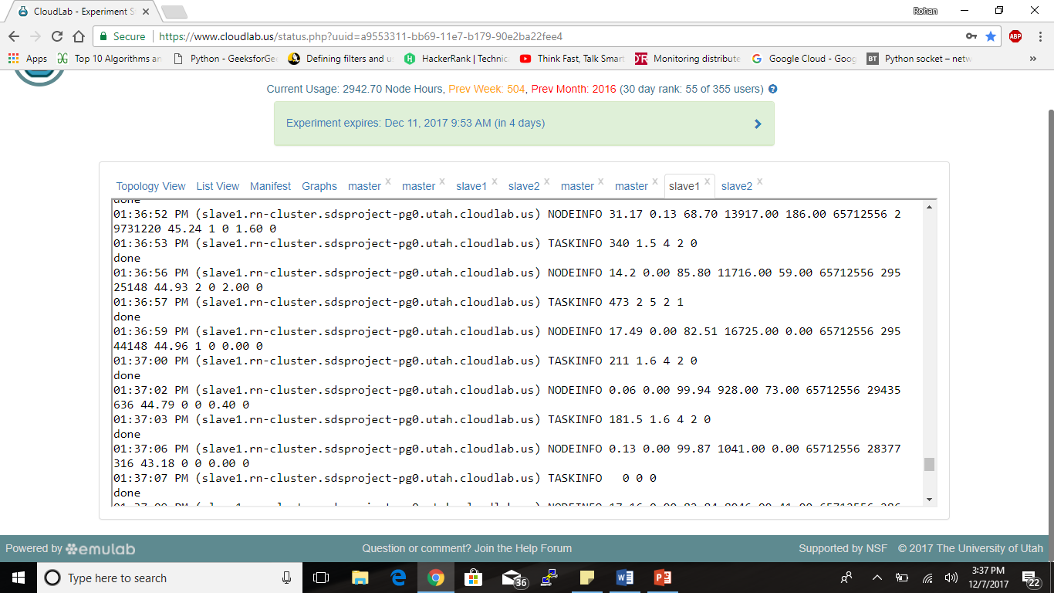
Local Monitor [NodeInfo: Timestamp, CPU usage (user+nice+system+steal), CPU (iowait), CPU (idle), number of context switches per second (CTSW), transactions per second (TPS), total memory of a node in KB, used memory in KB, used memory (%), size of the running queue, number of blocked tasks, max. device utilization, max. network interface utilization | TaskInfo: Timestamp, CPU usage (%) by MR tasks, memory usage (%) by MR tasks, number of containers used by tasks, number of AMs, number of YarnChild]

Slide 14
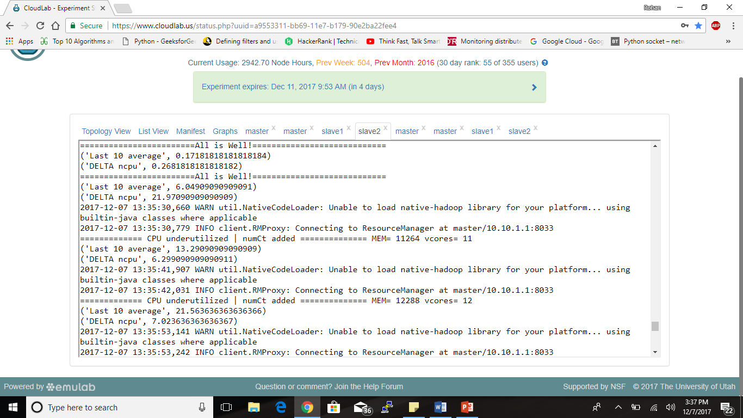
Local Controller

Slide 15
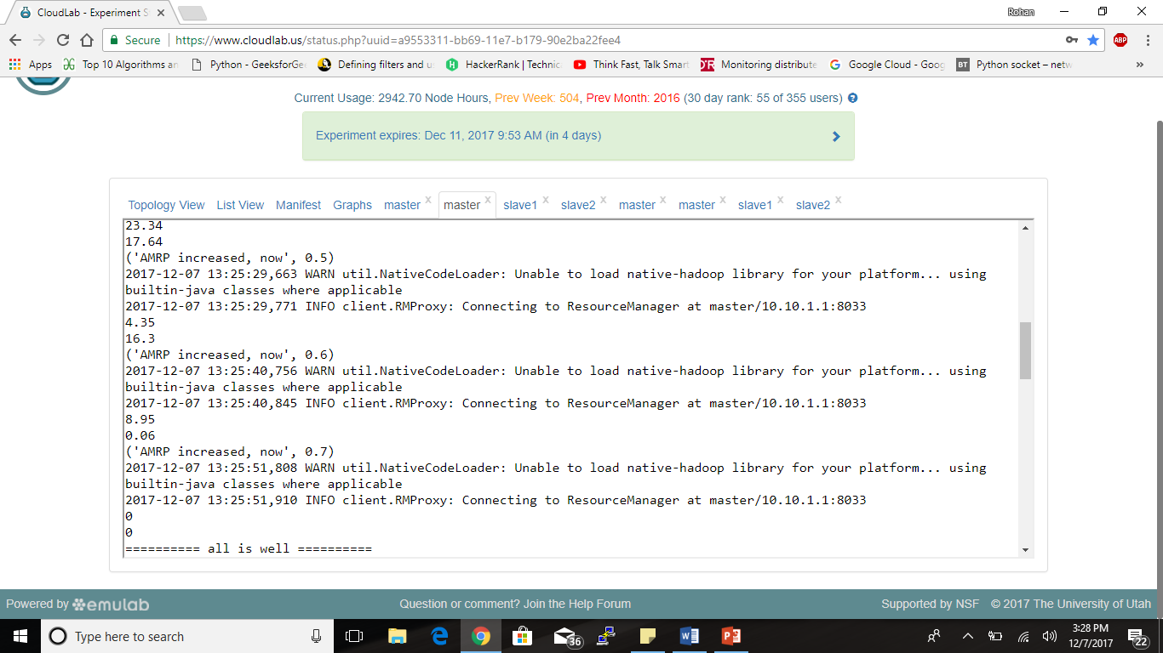
Global Controller

Slide 16
Results
The controller was tested (PS: without establishing synchronization between master and slave) and following observations were noted for a customized workload comprising of 2 Grep and 2 WordCount problems running concurrently.
As seen in table 1, the makespan does come down on using the controller (32%), but the readings are not sufficient and repeatable.
Controller parameters MaxContainers and AMRP were observed to change as per %CPU and control commands from 10 to 40 and 0.1 to 0.7 respectively

Slide 17
Areas of Improvement
Deviation: Difference of running containers and maxContainers could not be written to the files. File Permissions needed to be managed well
The moving average control algorithm needs to be studied under various workload and the size of moving window as well as the gain and other control parameters need to be determined.
A more realistic workload needs to be designed to test the implementation in all possible scenarios.

Slide 18
Areas of Improvement
A detailed study needs to be carried out to support this preliminary work so as to present more profound and accurate results.
We only took CPU usage as a deciding factor but some MR jobs are IO intensive as well. Therefore the controller design should include IOwait times, ContextSwitches, memory etc. into account for a holistic design.

Slide 19
Conclusion
A controller design with Dynamic reconfiguration at runtime, independent of the nature of job, is a feasible option to optimize Hadoop framework
Requires careful study and analysis of the controller design

Slide 20
Major Learning
Understanding of Software Defined Models
Powerful scripting and use of Hadoop Yarn APIs and other APIs
Insight into controller design –
parameters to be considered
complications involved
use of control theory in IT Systems
Working with cloudlab and a glimpse of IAC (genilib-script)

Slide 21
References
Lee, Gil Jae, and José AB Fortes. "Hadoop Performance Self-Tuning Using a Fuzzy-Prediction Approach." Autonomic Computing (ICAC), 2016 IEEE International Conference on. IEEE, 2016.
Lee, Gil Jae, and José AB Fortes. "Hierarchical Self-Tuning of Concurrency and Resource Units in Data-Analytics Frameworks." Autonomic Computing (ICAC), 2017 IEEE International Conference on. IEEE, 2017.
Kc, Kamal, and Vincent W. Freeh. "Dynamically controlling node-level parallelism in Hadoop." Cloud Computing (CLOUD), 2015 IEEE 8th International Conference on. IEEE, 2015.
https://hadoop.apache.org/docs/stable/hadoop-yarn/hadoop-yarn-site/YarnCommands.html
Vavilapalli, Vinod Kumar, et al. "Apache hadoop yarn: Yet another resource negotiator." Proceedings of the 4th annual Symposium on Cloud Computing. ACM, 2013.
https://docs.python.org/2/library/xml.etree.elementtree.html

Slide 22
Acknowledgment
I would like to sincerely thank Dr. Jose Fortes for allowing me to work on this project that has given me profound insight into software defined control system and also enhanced my scripting skills. I would also like to thank the TA Giljae Lee for his endless support throughout the project.
Demo
Questions?
Feedback

